Slide 1
VERTICAL PLAYBOOK
LCS ULTIMATE 2026

Slide 2
OFFENSE

Slide 3
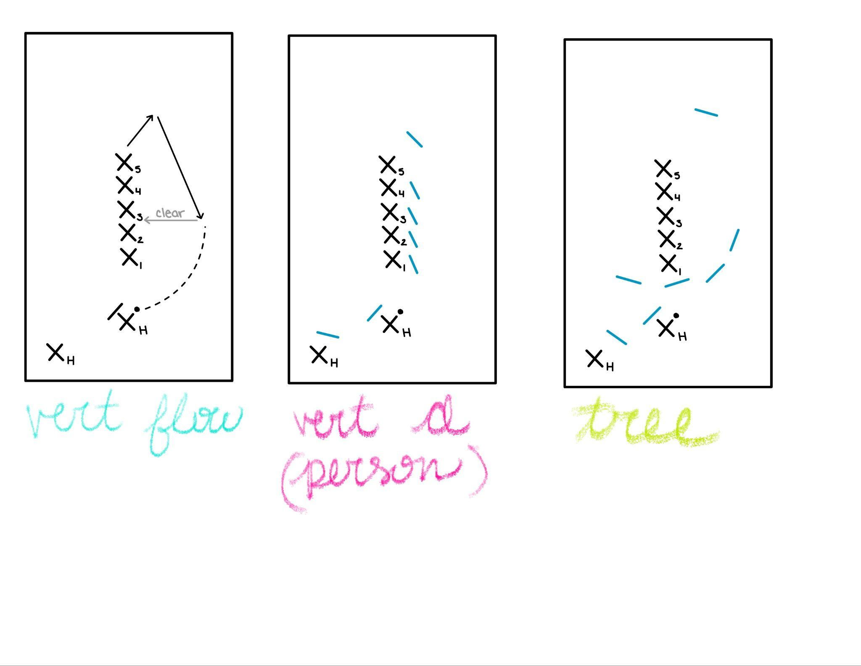
VERTICAL FLOW
Initiating cuts come from the back of the stack
First look should be under - use a juke or fake deep to get open
Clear to middle of the stack (position 3)
Stack moves with the play (push back as the disc moves down field)
ALWAYS MOVE AS A UNIT!
Reset to second handler at stall 4

Slide 4
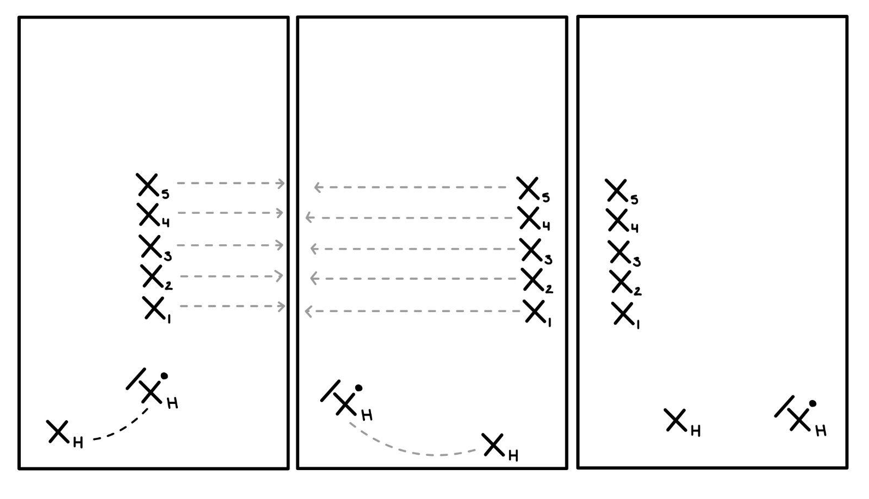
VERTICAL FLOW (BLOBBING)
Blobbing happens when the disc is swung between the handlers
Blobbing allows for us to make the most open-space on the field as possible
Blobbing happens as the disc is being swung, not when it is caught
If the disc moves to the home side, the stack blobs to the away side
If the disc moves to the away side, the stack blobs to the home side
*It is critical that the sideline and top of stack calls where to move / what side of the field the disc is moving to*

Slide 5
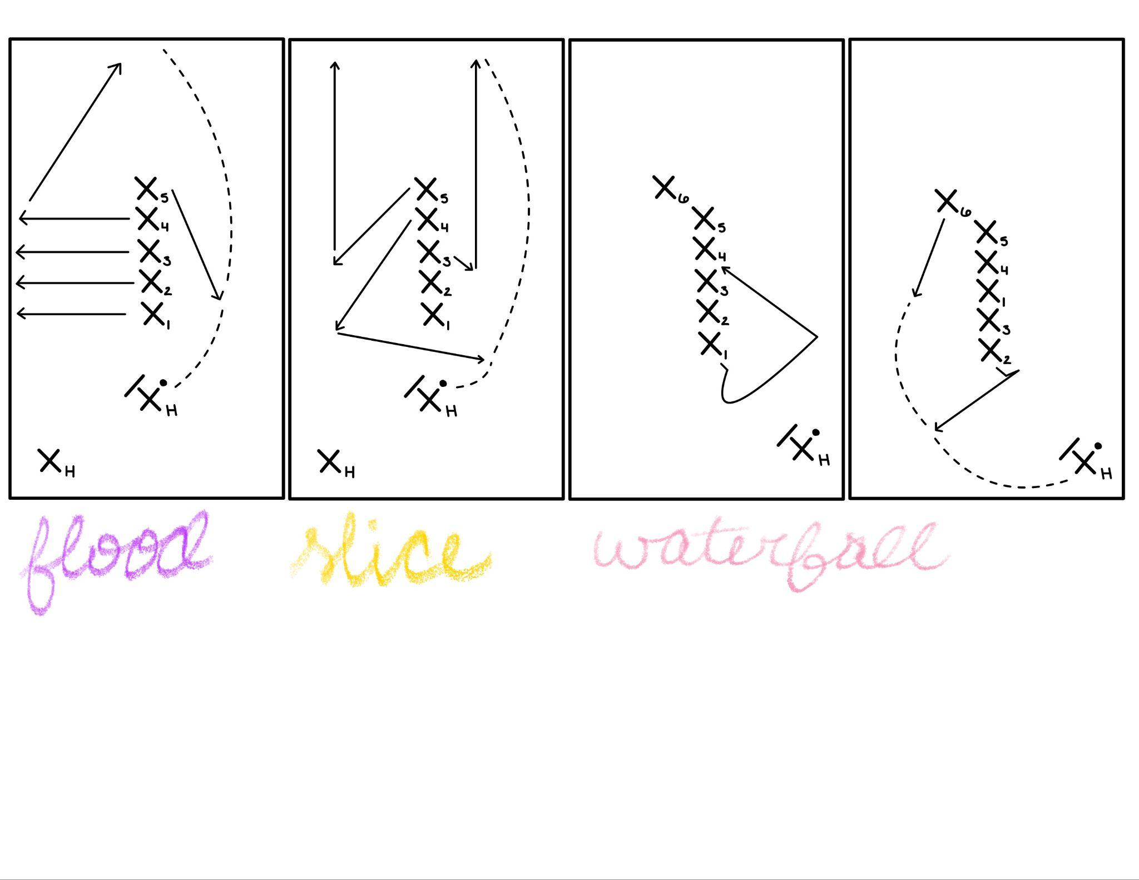
WATERFALL (SIDELINE)
6 players in stack, handler on sideline with disc
First look: top of stack does a scoop cut up the line - if open, back of stack strikes!
Not open, then clear to middle
Second look: second in the stack does a T-cut to get either up the line or around
Third look: third in the stack cuts straight out backfield for bail out reset
On Second or Third look, if disc is received backfield, continuation cut comes from back of the stack to the breakside

Slide 6
SLICE
SET UP
5 in the stack, 2 handlers out
Striker in position 3
Thrower in position 4
ORDER OF CUTS
Cutter 4 and 5 cut to break side simultaneously, cutter 4 crosses front of stack to receive disc
Cutter 3 strikes deep straight from stack as cutter 4 and 5 are completing their cuts
Cutter 5 is continuation for cutter 3
*Deep throw should be thrown so cutter 3 can catch it in motion

Slide 7
FLOOD
SET UP
5 in the stack, 2 handlers out
Thrower in position 5
Striker in position 4
ORDER OF CUTS
Stack (1-4) floods to break side
5 fakes the flood with the stack, then cuts under
4 floods with the stack initially, then strikes deep for 5 (come under if not there)
Stack returns to the middle after first continuation so we can continue the flow
*We can also call the under cut from a different position in the stack

Slide 8
DEFENSE

Slide 9
Vertical Person-Defense
Handlers (2) - play tight defense, take away easy reset throws
Watch for jam cuts in middle and berkley's on sideline
Back of stack - position yourself behind the last player, on the open side. Stay within an arm’s length away
Stack Cutters (1-4) - position yourself on the open side where you can see your player and the thrower, stay tight

Slide 10
TREE
Covering handlers (2) - Person D on handlers, hold the force, prevent easy reset passes
Top - Cover top of stack, play straight up and prevent throws into the middle of the stack. If player at the top of the stack cuts to either the break or open side, do not follow, that will leave the middle of the stack wide open
Open side (2) - Protect open side unders. Lots of communication when passing off or picking up a check
Break side - Taking any incoming break side threats to prevent a break-side huck. If 2 players cut your way, try to take away the wider option
Deep - pick up any incoming deep threats, communicate lots with downfield defenders
Picking up - this is not a zone! Pick up a player who comes into the area you are taking. As soon as anyone has picked up a player, or 1 pass goes off, call “pick up!” to signal that we are playing person defense

